Slide 1

Armed Forces College of Medicine
AFCM

Slide 2
Approach to Constipation & Diarrhea Prof. Mohamed Hassan Fouad, MD, MRCP(UK)

Slide 3
Intended Learning Outcome (ILO)
At the end of this Lecture you will
List the causes of Diarrhoea and Constipation
Recognize how to diagnose and manage Diseases of the Small intestine and Diseases of the Large Intestine

Slide 4
Diarrhea Definition
Definition:
Stools that are loose
and/or frequent (i.e. ≥3x per day)
or 24 h stool weight >200 g

Slide 5
Diarrhea Classification
Diarrhea has several classifications that include:
Acute (<2 weeks) vs Chronic (> 4 weeks)
Small volume (colonic) vs large volume (small bowel)
Watery: Secretory vs Osmotic (stops with fasting)
Vs Fatty: Steatorrhea (Malabsorbtion)
Vs Inflammatory: Bloody
Functional (stops with sleep) vs Organic (with structural colonic disease)

Slide 6
Acute Diarrhea
Passage of frequent unformed stools for <14 d
Etiology
Most commonly due to infections
Most infections are self-limiting and resolve within 7 d
Risk Factors
Food (seafood, chicken, turkey, eggs, beef)
Medications: antibiotics, laxatives
Others: high risk sexual activity, infectious outbreaks, family history (IBD)

Slide 7
Etiology
Non Inflammatory | Inflammatory
Normal mucosa | Mucosal disruption | Definition
Stimulation of intestinal water secretion | Organisms and toxins invade mucosa | Mechanism
Small intestinal | Colonic | Site
Normal mucosa | Abnormal mucosa | Sigmoidoscopy
Watery Large Volume Periumbilical pain | Bloody Small Volume High Frequency Urgency & Tenesmus | Symptoms
Negative fecal WBCs and RBCs | Fecal WBCs and RBCs | Stool Analysis
Fluid & Electrolyte Imbalance | Megacolon | Complications

Slide 8
Investigations
Stool cultures/microscopy (C&S/O&P)
C&S tests Campylobacter, Salmonella, Shigella, E. coli
Flexible sigmoidoscopy if inflammation suspected
Biopsies for IBD (Crohn’s disease and ulcerative colitis)
C. difficile toxin: when recent antibiotic use, hospitalization, nursing home, or recent chemotherapy

Slide 9
Management
Fluid and electrolyte replacement
Anti-diarrheals
- Antimotility agents: diphenoxylate, loperamide
Absorbants: kaolin/pectin, methylcellulose, activated attapulgite acting by absorbing intestinal toxins/micro-organisms, or coating intestinal mucosa
Modifiers of fluid transport: bismuth subsalicylate
Should not be used in bloody diarrhea or fever
Antibiotics: rarely indicated.

Slide 10
Chronic Diarrhea & Malabsorbtion
Maldigestion: inability to break down large molecules in the lumen of the intestine
Malabsorption: inability to transport molecules across the intestinal mucosa into circulation

Slide 11
Causes of Maldigestion
Specific enzyme deficiencies (e.g. lactase)
Inadequate food mixing with enzymes (gastrectomy)
Terminal ileal disease (impaired recycling), bacterial overgrowth (deconjugation of bile salts)
Liver disease (cholestatic PBC)
Biliary disorders
Pancreatic disorders

Slide 12
Causes of Malabsorbtion
Inadequate absorptive surface
Infections/infestations (e.g. Whipple’s disease, Giardia)
Immunologic or allergic injury (e.g. celiac disease)
Infiltration (e.g. lymphoma, amyloidosis)
Fibrosis (e.g. systemic sclerosis, radiation enteritis)
Bowel resection (length, site, location, presence/absence of ileocecal valve are important)
Extensive ileal Crohn’s disease.

Slide 13
Causes of Malabsorbtion
Drug-induced
Cholestyramine, ethanol, neomycin, tetracycline and antibiotics
Endocrine
DM (complex pathogenesis)

Slide 14
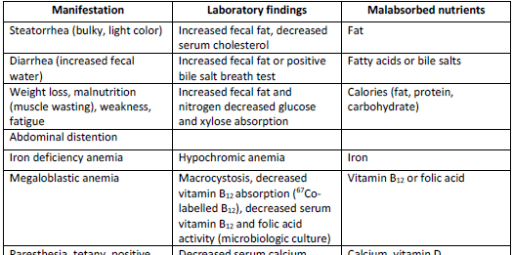
Manifestations of MAS and Corresponding Lab Abnormalities

Slide 15
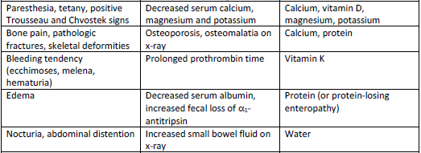
Manifestations of MAS and Corresponding Lab Abnormalities

Slide 16
Investigations and Treatment
Routine lab tests: Anemia (iron def), prolonged INR (Vit K def), decreased electrolytes (K, Ca, Mg, etc)
Special markers: Anti-TTG (Celiac Disease), ANCA & ASCA (IBD)
Stool tests: Stool analysis and C/S, 72 h stool collection (documents steatorrhea ), Fecal elastase for pancreatic insufficiency, fecal calprotectin, stool fat globules stained with Sudan for steatorrhea

Slide 17
Investigations and Treatment
Imaging studies (e.g. CT scan/MRI to visualize pancreas, liver, GB and GI lumen)
Endoscopy (Upper endoscopy, enteroscopy, Colonoscopy)
Tissue biopsy and Histopathology specific for some causes
Treatment
Dependent on underlying etiology

Slide 18
Celiac Disease
Disturbed small intestine function with impaired absorption, particularly of fats in response to gluten found in wheat, barley, oats, rye; filler in many prepared foods and medications.

Slide 19
Pathology
• Flattening of intestinal mucosa and partial atrophy of villi in the small intestine.
• Degenerative changes in the myenteric nerve plexuses.
• Loss of villi → loss of microvilli → disaccharidase deficiency (particularly, lactase).
• This will lead to defective absorption of fat, protein, carbohydrates, iron and water, fat soluble vitamins A, D, K. and protein loss from small intestine.
.

Slide 20
Symptoms
In one third of patients with celiac sprue, symptoms begin in early childhood.
It can present with infantilism, dwarfism, tetany, vitamin deficiency signs, rickets.
Symptoms may persist into adult life, but there is usually a latent phase of apparent good health.
Anemia: hypochromic, microcytic.
Dermatitis herpetiformis: frequent association

Slide 21
Diagnosis
Quantitative measurements of fecal fat
Upper endoscopy shows scalloping of duodenal folds
Partial villous atrophy in small bowel biopsy.
Anti-TTG, Anti-endomysiium, Anti-Gliadin antibodies

Slide 22
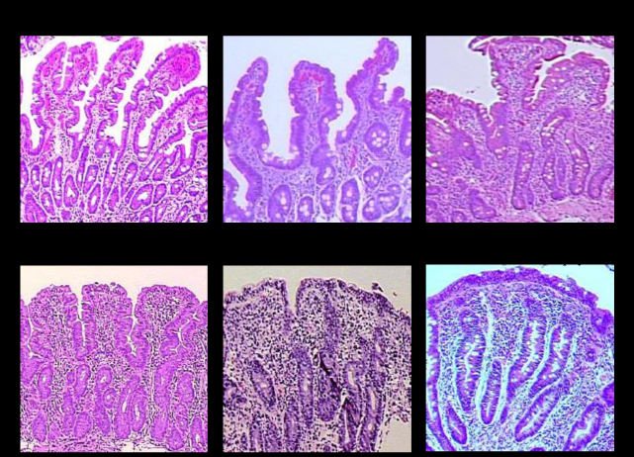
Normal Villi vs Partial Atrophy

Slide 23
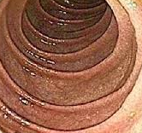
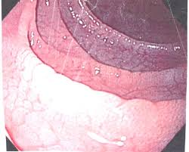
Normal VS Scalloped Duodenum

Slide 24
Treatment
Strict elimination of gluten.
Diet: gluten-free and initially lactose-free. High-calorie, high-protein, low-fat.
Prothrombin deficiency: water-soluble vitamin K orally.
Hypocalcemia or tetany: calcium phosphate or gluconate and vitamin D.
Macrocytic anemia: vitamin B12
Corticosteroids: in severe forms.

Slide 25
Prognosis
Proper treatment leads to good response.
A late increased incidence of abdominal lymphomas and carcinomas was noticed if left untreated.

Slide 26
Definition of Constipation
Constipation is defined as the passage of
Infrequent
or hard stools with straining (stool water <50 mL/d)
Or frequency < 3 times/week

Slide 27
Etiology of Constipation
Pain - Fissure
Psychological - Depression
Cancer colon
Collagen disease - Scleroderma
Idiopathic – Most common
Intestinal obstruction
Neurologic – Parkinson, MS
Metabolic – Diabetes, Hypothyroid, High Ca, Low K
Medications – Calcium, Iron

Slide 28
Investigations
CBC
ESR
Stool
CT Colonography
MR Defecography
Colonoscopy
TFTs, Calcium

Slide 29
Treatment – Life Style Modifications
Increase fiber intake
Adding fiber to diet increases the weight of stool and speeds its passage through intestines. Slowly begin to eat more fresh fruits and vegetables each day. Choose whole-grain breads and cereals.
Exercise most days of the week
Physical activity increases muscle activity in intestines.
Avoid ignoringthe urge to have a bowel movement

Slide 30
Treatment – Drug Therapy
Fiber supplements: Fiber supplements add bulk to stool. Bulky stools are softer and easier to pass. Fiber supplements include psyllium, calcium polycarbophil and methylcellulose.
Stimulants: Stimulants including bisacodyl and sennosides cause intestines to contract.
Osmotics: Osmotic laxatives help stool move through the colon by increasing secretion of fluid from the intestines and helping to stimulate bowel movements. Examples include oral magnesium hydroxide, magnesium citrate, lactulose and polyethylene glycol

Slide 31
Treatment
Lubricants: Lubricants such as mineral oil enable stool to move through your colon more easily.
Stool softeners: Stool softeners such as docusate sodium and docusate calcium moisten the stool by drawing water from the intestines.
Enemas and suppositories
Glycerin or bisacodyl suppositories also aid in moving stool out of the body by providing lubrication and stimulation.

Slide 32
Treatment
Medications that draw water into your intestines: A number of prescription medications are available to treat chronic constipation. Lubiprostone, linaclotide and plecanatide work by drawing water into intestines and speed up the movement of stool.
Serotonin 5-hydroxytryptamine 4 receptors. Prucalopride helps move stool through the colon.

Slide 33
Treatment
Peripherally acting mu-opioid receptor antagonists (PAMORAs). If constipation is caused by opioid pain medications, PAMORAs such as naloxegol and methylnaltrexone reverse the effect of opioids on the intestine to keep the bowel moving.

Slide 34
Slow Transit Constipaion
Colonic transit time can me measured by abdominal x-ray using radio opaque markers.
Normal time is 70 hrs.
Normal transit time means IBS (Misperception of normal defecation)
Prolonged transit time throughout means colonic inertia (Infrequent motion with bloating that tends to occur in youth)
Outlet obstruction means inability to coordinate muscles of the pelvis to empty the rectum and it usually occurs in old age

Slide 35
Slow Transit Constipaion
Colonic transit time can me measured by abdominal x-ray using radio opaque markers.
Normal time is 70 hrs.
Normal transit time means IBS (Misperception of normal defecation)
Prolonged transit time throughout means colonic inertia (Infrequent motion with bloating that tends to occur in youth)
Outlet obstruction means inability to coordinate muscles of the pelvis to empty the rectum and it usually occurs in old age

Slide 36
Definition of Cancer Colon
Colon cancer is the fourth most common cancer (after lung, prostate, and breast)
It represents the second most common cause of cancer death mostly due to adenoma-carcinoma sequence
It rarely arises de novo

Slide 37
Risk Factors of Colon Cancer
• Age >50 (dominant risk factor in sporadic cases), mean age is 70
• Genetic: FAP, HNPCC, family history of CRC
• Adenomatous polyps (especially if >1 cm, villous, multiple)
• IBD (especially UC: risk is 1-2%/yr if UC >10 yr)

Slide 38
Risk Factors of Colon Cancer
• IBD (especially UC: risk is 1-2%/yr if UC >10 yr)
• Previous colorectal cancer (also gonadal or breast)
• Diet (High fat, red meat, decreased fibre) and smoking
• DM and acromegaly (insulin and IGF-1 are growth factors for colonic mucosal cells)

Slide 39
Presentation
Rectum | Left Colon | Right Colon
 | 35% | 25% | Frequency
Ulcerating | Annular, Invasive | Exophytic with occult bleeding | Pathology
Obstruction Tenesmus Rectal Bleed | Constipation with overflow Pain Thin stool Rectal Bleed | Weight loss | Symptoms
Palpable on DRE BRBPR | BRBPR Left bowel obstruction | Iron deficiency anemia RLQ mass | Signs

Slide 40
Investigations
• Colonoscopy (best), look for synchronous lesions (3-5% of patients)
• If a patient is FOBT +ve, or has microcytic anemia or has a change in bowel habits, do colonoscopy
• CBC, urinalysis, liver enzymes, LFTs, CEA
• Staging: CT chest/abdomen/pelvis; bone scan
• Rectal cancer: pelvic MRI or endorectal U/S

Slide 41
Management
Wide surgical resection of lesion and regional lymph drainage; colectomy with primary anastomosis
Curative: wide resection of lesion (5 cm margins) with nodes (>12) and mesentery
Metastatic lesions confined to liver can be resected
Palliative: if distant spread, local control for hemorrhage or obstruction
Adjuvant chemotherapy

Slide 42
IBS
Definition: a form of functional bowel disease; more than just a label for GI symptoms unexplained after normal investigations.

Slide 43
Rome 4 Criteria for IBS
The Rome IV criteria for the diagnosis of irritable bowel syndrome require that patients have had recurrent abdominal pain on average at least 1 day per week during the previous 3 months that is associated with two or more of the following :

Slide 44
Rome 4 Criteria for IBS
Related to defecation (may be increased or unchanged by defecation)
Associated with a change in stool frequency
Associated with a change in stool form or appearance

Slide 45
Differential Diagnosis
IBS Mimickers
Enteric Infections (Giardia)
Lactose Intolerence
Crohn s disease
Celic disease
Drug induced diarrhwa
Diet induced diarrhea

Slide 46
Investigating IBS
Aim to rule out organic pathology by:
CBC
ESR, CRP, Calprotectin
Stool analysis and C&S
TSH
Celiac serology (Anti – TTG)
Consider imaging and colonoscopy (Above 50)

Slide 47
Algorithmic Approach to IBS Diagnosis

Slide 48
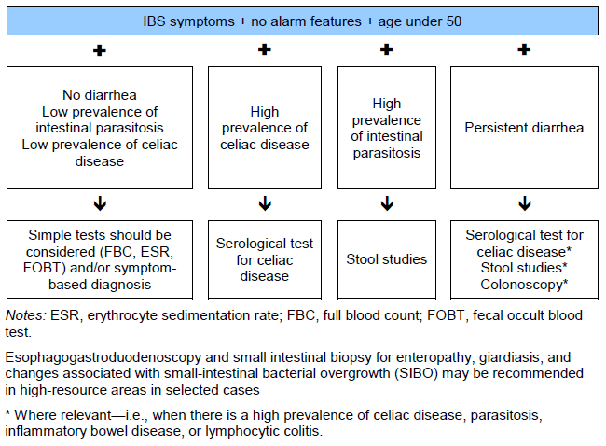

Slide 49
IBS Management Algorithm

Slide 50
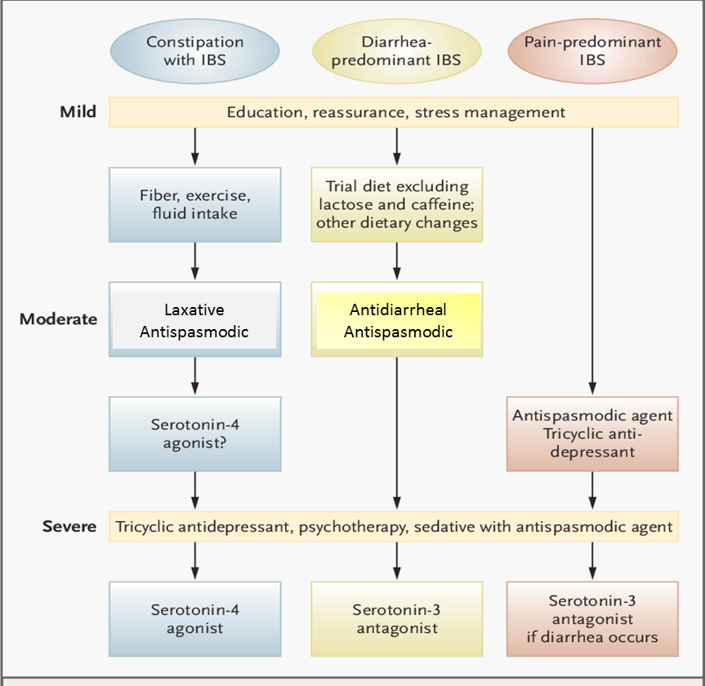

Slide 51
Commonly used IBS Agents
Diarrhea
Pain
Refractory IBS ± Comorbidity
Bloating
Constipation
5HT3 antagonists (Alosetron)
Eluxadoline
Bile acid binders
5HT3 antagonists
Rifaximin
Eluxadoline
Linaclotide
Lubiprostone
5HT4 agonist
Anti- spasmodic
Anti- depressants
Rifaximin
Eluxadoline
Linaclotide
Lubiprostone
5HT4 agonist
Fiber
Osmotic Laxatives
Linaclotide
Lubiprostone
5HT4 agonist (Tegaserod)
SSRI
SNERI
TCAs
Anti- psychotic
CBT
Hypno-therapy
Rifaximin

Slide 52
Prognosis
80% improvement
Normal life expectancy

Slide 53
Quiz
A 37-year-old woman presents with a two days history of diarrhoea with blood about 5 times per day associated with fever, nausea and vomiting. There is no Past Medical History of importance and on no repeated medications.
What is the likely diagnosis?
Crohn s disease
Colon Cancer
Enterohemorrhagic infection
Ulcerative colitis
Viral enteritis

Slide 54
Quiz
A 37-year-old woman presents with a two days history of diarrhoea with blood about 5 times per day associated with fever, nausea and vomiting. There is no Past Medical History of importance and on no repeated medications.
What is the likely diagnosis?
Crohn s disease
Colon Cancer
Enterohemorrhagic infection
Ulcerative colitis
Viral enteritis

Slide 55
Quiz
A 35 year old lady presents with long history of constipation. She pass < 2 bowel movements per week & has been laxative dependence since childhood, She denies any FH of cancer colon. Examination is normal. CBC: Hb: 13 mg%, MCV is normal.
What is the most probable diagnosis?
Cancer colon
Crohn’s disease
IBS
Intestinal obstruction
Slow transit constipation

Slide 56
Quiz
A 35 year old lady presents with long history of constipation. She pass < 2 bowel movements per week & has been laxative dependence since childhood, She denies any FH of cancer colon. Examination is normal. CBC: Hb: 13 mg%, MCV is normal.
What is the most probable diagnosis?
Cancer colon
Crohn’s disease
IBS
Intestinal obstruction
Slow transit constipation

Slide 57
Quiz
A 51 year old man presents with alternating constipation & diarrhoea with occasional blood of three months duration. He also noticed loss of about 4 Kg of his weight over the last six months. He has no Past Medical History of importance and denies any new medications. Examination is normal. CBC: Hb: 10 mg%, MCV is low

Slide 58
Quiz
What would be your next step?
A- Abdominal X-ray
B- Abdominal CT
C- Full colonoscopy
D- IV iron therapy
E- Sigmoidoscopy

Slide 59
Quiz
What would be your next step?
A- Abdominal X-ray
B- Abdominal CT
C- Full colonoscopy
D- IV iron therapy
E- Sigmoidoscopy

Slide 60
Quiz
A 35 year old lady presents with long history of alternating diarrhoea with constipation associated with intermittent abdominal pain, mucus, sense of incomplete evacuation & bloating. Her symptoms increased by stress, and her pain is usually relieved by defecation, Examination is normal. CBC: Hb: 12 mg%, MCV is normal. ESR, CRP and stool analysis are normal.

Slide 61
Quiz
What is the Diagnosis?
A- Colon Cancer
B- Colonic Stricture
C- Defecatory disorder
D- Functional Constipation
E- IBS

Slide 62
Quiz
What is the Diagnosis?
A- Colon Cancer
B- Colonic Stricture
C- Defecatory disorder
D- Functional Constipation
E- IBS

Slide 63
Quiz
A 30-year-old woman sees a doctor for chronic diarrhoea, flatulence, weight loss and fatigue. Examination shows tympanetic distended abdomen and pruritic, papulovesicular skin lesions involving the extensor surfaces. Her labs show anaemia with haemglobin 8 gm/dL.

Slide 64
Quiz
What is your diagnosis?
A- Celiac Disease
B- ColonCancer
C- Food Poisoning
D- IBS
E- Ulcerative Colitis

Slide 65
Quiz
What is your diagnosis?
A- Celiac Disease
B- ColonCancer
C- Food Poisoning
D- IBS
E- Ulcerative Colitis

Slide 66
Take Home Message
We should differentiate between causes of acute and chronic diarrhea
We should differentiate between functional and organic GIT Disorders
We should always exclude malignancy especially in high risk population with alarming signs

Slide 67
Suggested TextBooks
Andreoli and Carpenter’s Cecil Essentials of Medicine (9th ed.) Benjamin IJ, Griggs RC, Wing EJ, Fitz JG (Eds.) (2016). Andreoli and Carpenter’s Cecil Essentials of Medicine (9th ed.). Philadelphia, PA: Elsevier Saunders.
Essential Med Notes (or Toronto notes): Binesh-Marvasti T, McQueen S (Eds) (2018). Essential Med Notes 2018: Comprehensive Medical Reference and Review for USMLE II and MCCQE (34th ed.). Toronto, Ontario, Canada: Toronto Notes for Medical Students, Inc.

Slide 68
Thank You

